Slide 1
WEEK 16 PROJECT MANAGEMENT
CONTROL QUALITY

Slide 2
8.3 Control Quality
Control Quality is the process of monitoring and recording results of executing the quality activities to assess performance and recommend necessary changes. The key benefits of this process include: (1) identifying the causes of poor process or product quality and recommending and/or taking action to eliminate them; and
(2) validating that project deliverables and work meet the requirements specified by key stakeholders necessary for final acceptance. The inputs, tools and techniques, and outputs of this process are depicted in Figure 8-11. Figure 8-12 depicts the data flow diagram of the process.

Slide 3
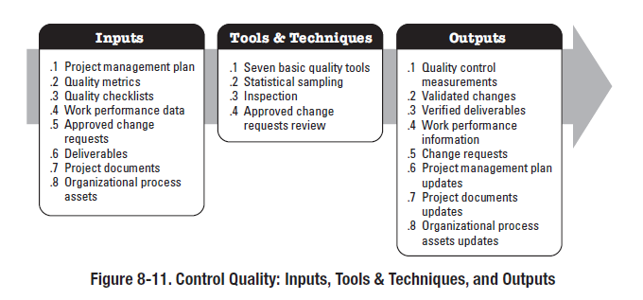

Slide 4
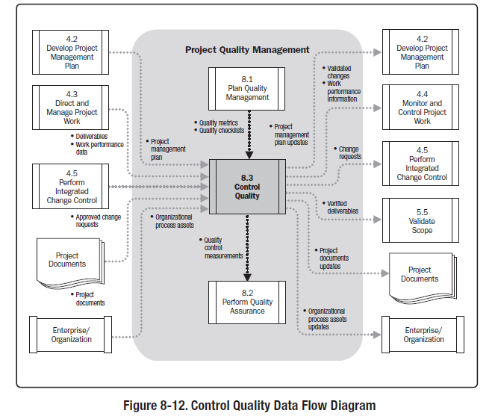

Slide 5
1 Control Quality: Inputs
1 Project Management Plan
The project management plan contains the quality management plan, which is used to control quality. The quality management plan describes how quality control will be performed within the project.
2 Quality Metrics
A quality metric describes a project or product attribute and how it will be measured. Some examples of quality metrics include: function points, mean time between failure (MTBF), and mean time to repair (MTTR).

Slide 6
3 Quality Checklists
Quality checklists are structured lists that help to verify that the work of the project and its deliverables fulfill a set of requirements.
4 Work Performance Data
Work performance data can include:
• Planned vs. actual technical performance,
• Planned vs. actual schedule performance, and
• Planned vs. actual cost performance.
5 Approved Change Requests
As part of the Perform Integrated Change Control process, a change log update indicates that some changes are approved and some are not. Approved change requests may include modifications such as defect repairs, revised work methods, and revised schedule. The timely implementation of approved changes needs to be verified.

Slide 7
6 Deliverables
A deliverable is any unique and verifiable product, result, or capability that results in a validated deliverable required by the project.
7 Project Documents
Project documents may include, but are not limited to:
• Agreements,
• Quality audit reports and change logs supported with corrective action plans,
• Training plans and assessments of effectiveness, and
• Process documentation such as those obtained using either the seven basic quality tools or the quality
management and control tools shown in Figures 8-7 and 8-10.
8.3.1.8 Organizational Process Assets
The organizational process assets that influence the Control Quality process include,
but are not limited to:
• The organization’s quality standards and policies,
• Standard work guidelines, and
• Issue and defect reporting procedures and communication policies.

Slide 8
2 Control Quality: Tools and Techniques
1 Seven Basic Quality Tools
The seven basic quality tools are illustrated conceptually in Figure 8-7.
2 Statistical Sampling
Samples are selected and tested as defined in the quality management plan.
3 Inspection
An inspection is the examination of a work product to determine if it conforms to documented standards. The results of an inspection generally include measurements and may be conducted at any level. For example, the
results of a single activity can be inspected, or the final product of the project can be inspected. Inspections may be called reviews, peer reviews, audits, or walkthroughs. In some application areas, these terms have narrow and specific meanings. Inspections also are used to validate defect repairs.
4 Approved Change Requests Review
All approved change requests should be reviewed to verify that they were implemented as approve

